Slide 1



AIR QUALITY MONITORING AND PREDICTION SYSTEM (AQMPS)
L J Institutes of Engineering and Technology
AREA - MACHINE LEARNING
Presented By:
Bhavya Bhimani(170320107012)
Mit Desai(170320107019)
Meet Gohil (170320107520)
Guided By :
Ankit Patel
Assistant Professor

Slide 2
INTRODUCTION

Slide 3


Environment is important for the survival of living beings.
But, we have polluted this environment to a very great extent which has
affected the climate resulting into various problems such as global warming.
Major causes for pollution are:
Vehicular Pollution
Industrial Pollution

Slide 4
Air Quality Index (AQI) is a value which is used to show the pollution level in a particular region.
Computation of AQI requires 6 major components of pollution.
The highest pollutant level of the 6 pollutant components is the AQI.
Carbon Monoxide (CO)
Ozone (O3)
PM 2.5
Pollutants
PM 10
Sulphur Dioxide (SO2)
Nitrogen Dioxide (NO2)

Slide 5
LIMITATIONS OF THE EXISTING SYSTEM

Slide 6
Real time air quality index was not available to general public.
Tempering of real time pollutant reading.
Absence of proper User Interface(UI) between industries and government regarding Air Quality Index and measurement of pollutants.
Absence of prediction mechanisms to forecast.

Slide 7
OBJECTIVES

Slide 8
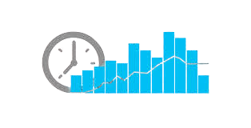
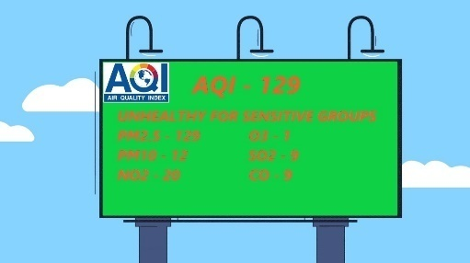

Display of real time data to general public.
Provide real time data of
various pollutants.
Provide better UI for industry and government communication

Slide 9
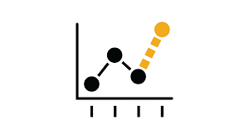


Predict AQI based on variouds machine learning algorithms.
Provides data visualizations for better understanding
Provide services like license application and online payment on a single platform

Slide 10
ABOUT THE PROJECT

Slide 11
Air Quality
Monitoring and Prediction System
Device Construction (Hardware)
Data Presentation
Data Prediction

Slide 12
Device Construction
Involves construction of the hardware device using various sensors to measure the pollution.
The monitoring system would be installed in the industries and at major road junctions.
The pollution generated would be sensed by the device and recorded in the database.
This recorded data would be used by the government agencies for analysis of industry’s performance.

Slide 13
The device is constructed as follows :
MQ7 CO sensor is attached to the Arduino.
GP2Y100 sensor is attached to measure PM 2.5.
The above 2 sensors are connected to Arduino.
Arduino transfers the data collected from these sensors to NodeMCU ESP8266 Device via I2C communication channel.
There is a WIFI module onboard the NodeMCU ESP8266 which transmits the data to the MySQL database.

Slide 14
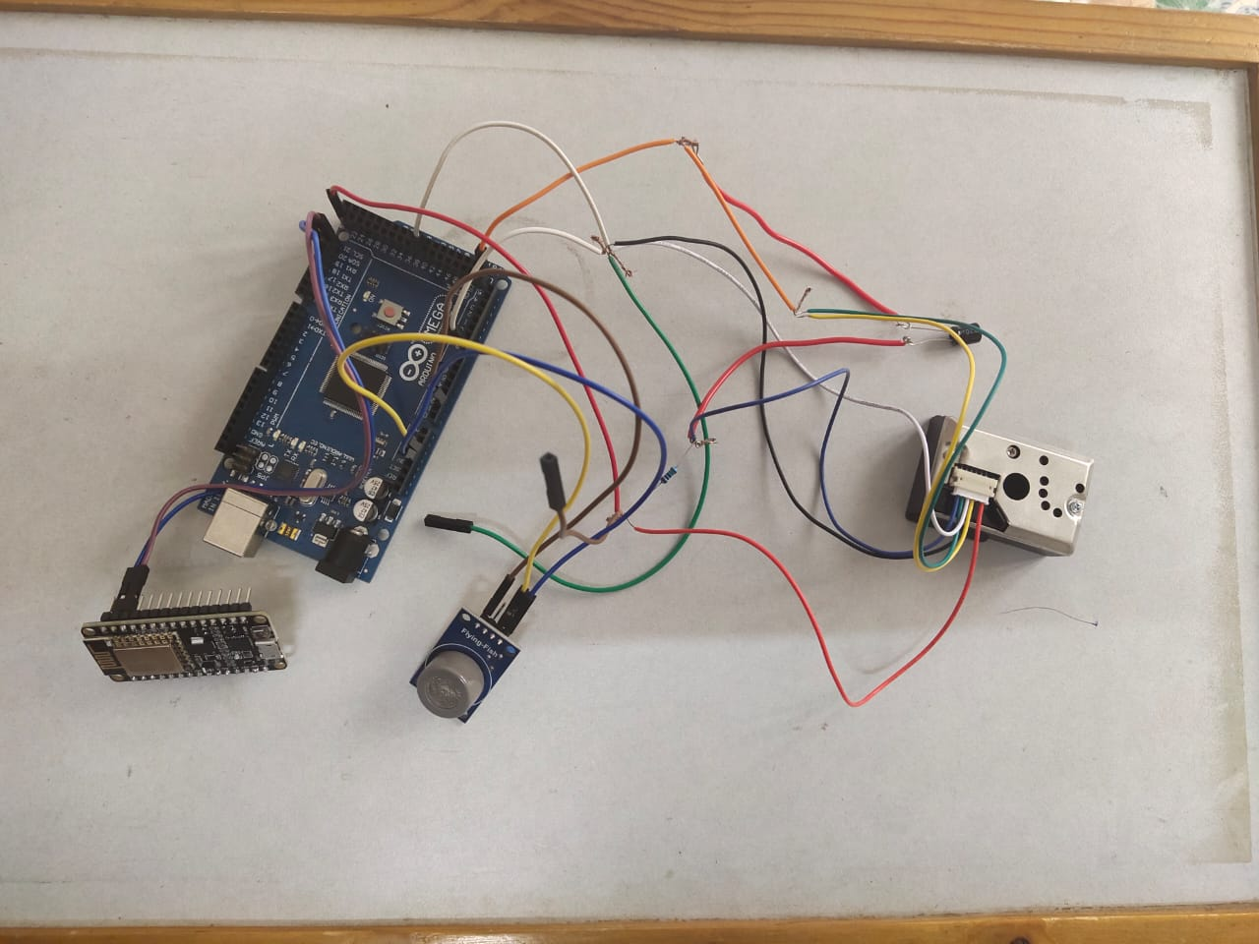
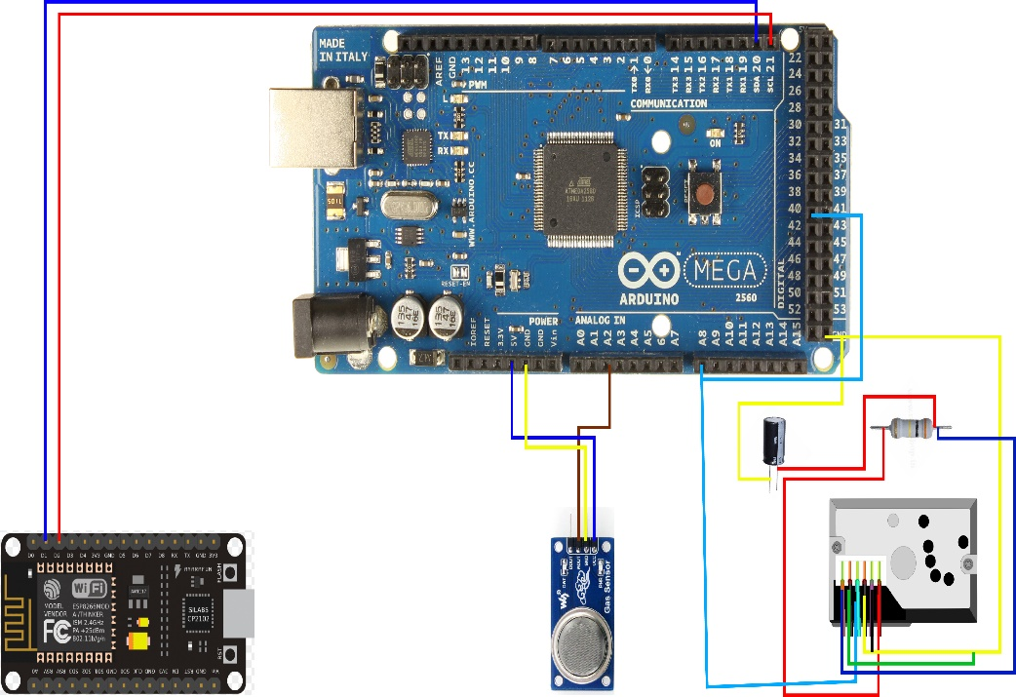
The device after connection
The schematic diagram of the circuit .

Slide 15
Data Presentation
Provides a website representation for viewing of pollution levels and the Air Quality Index of a particular region.
Provides various data visualizations for the general public to understand the pollution levels in their respective area.
The website also forms a User Interface for communication between government agencies and industries regarding license procedures, closures and revocation and many other facilities.

Slide 16
Data Presentation
It is a PHP based website with MYSQL database used at backend.
The website provides functionality help the client in applying for a license required to operate an industry.
The website also provides the functionality for the government employees to easily approve or reject license application along with closing and revoking of industries based on their pollution levels

Slide 17
Data Prediction
The prediction part provides forecast for the pollution levels and Air Quality Index in the near future.
Time series algorithm is utilized for such type of prediction.
The forecast is made on the basis of data collected and stored by the hardware along with the weather data collected from meteorological departments.
Such forecast would help people plan or schedule their travel accordingly.

Slide 18
Data Prediction
The prediction part provides forecast for the pollution levels and Air Quality Index in the near future.
Time series algorithm is utilized for such type of prediction.
The forecast is made on the basis of data collected and stored by the hardware along with the weather data.
Such forecast would help people plan or schedule their travel accordingly.

Slide 19
Flow of the project
01
Data Collection by hardware device.
Get the real time data of pollutant levels of pollutants from factories.
02
Store the collected data in real time database.
Storing the data in the database and maintaining the database.
03
Using the prediction algorithm for prediction of future data.
Prediction is made on stored data using machine learning algorithms.
04
Storing predicted data in database.
The predicted data is stored in a separate database.
05
Providing user interface of current as well as predicted data.
The current and predicted data is displayed on interactive website.

Slide 20
TOOLS AND TECHNOLOGIES

Slide 21










MySQL
PHP
Laptop/Desktop
Python
Wifi
Git
Tensorflow
Machine Learning and Prediction Model
ARDUINO
CSS
HTML

Slide 22
SNAPSHOTS

Slide 23
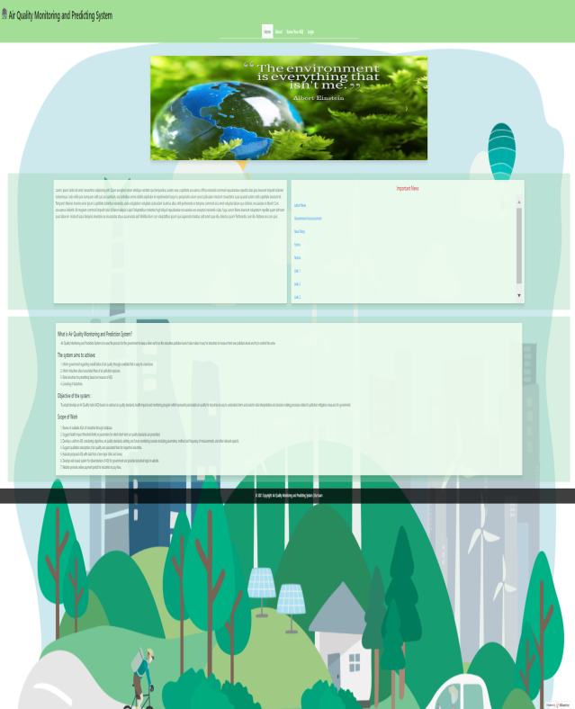
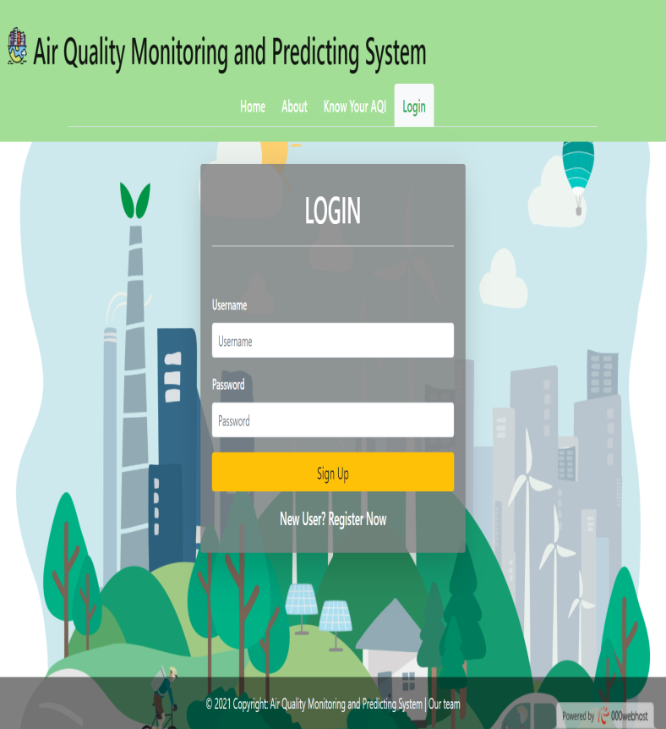
HOME PAGE
LOGIN PAGE

Slide 24
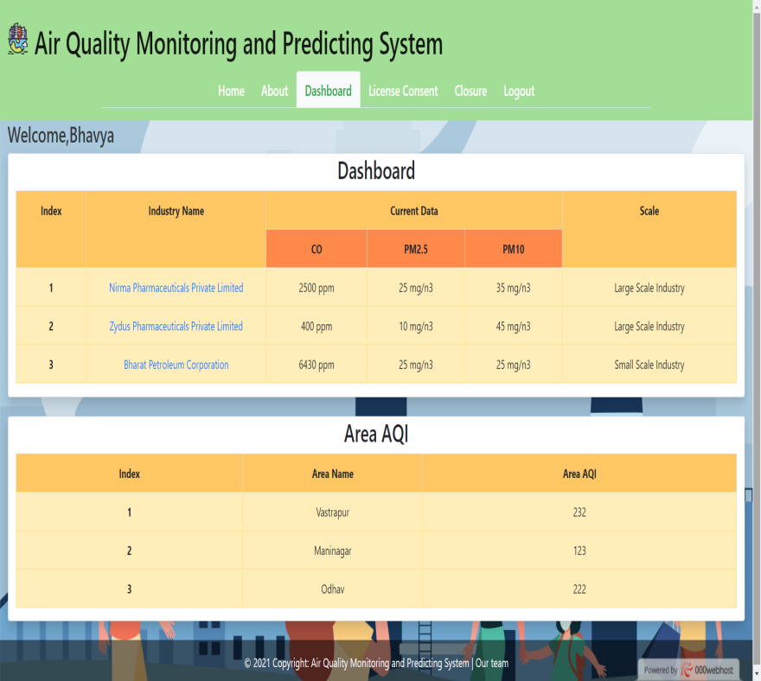
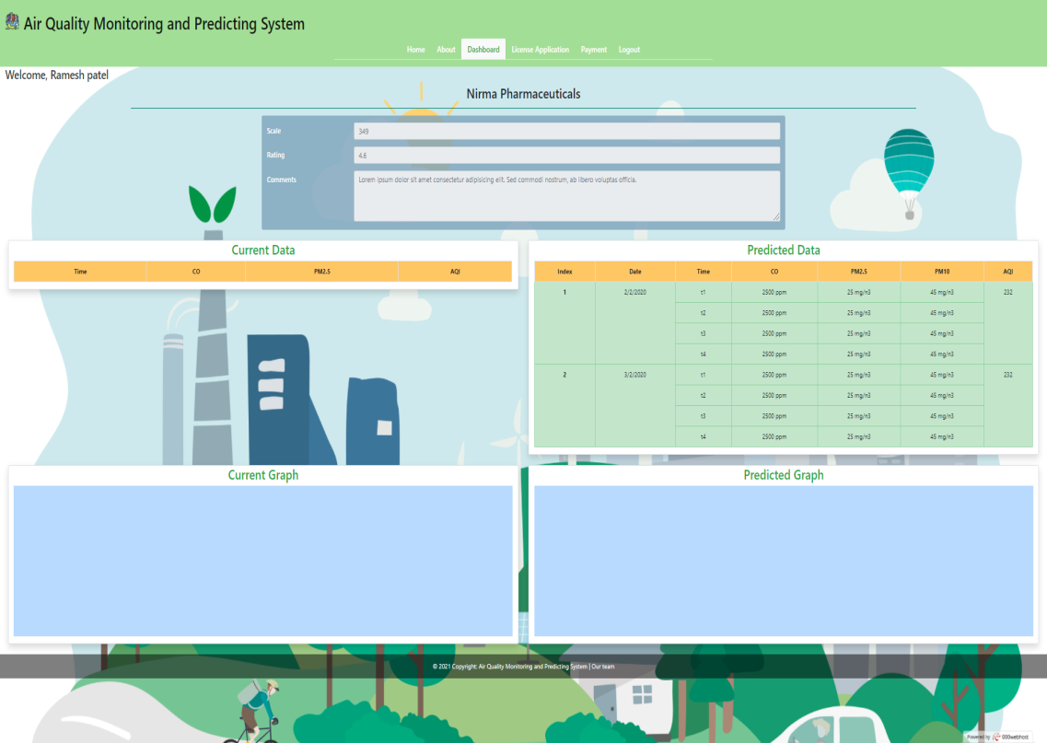
GOVERNMENT DASHBOARD
INDUSTRY DASHBOARD

Slide 25
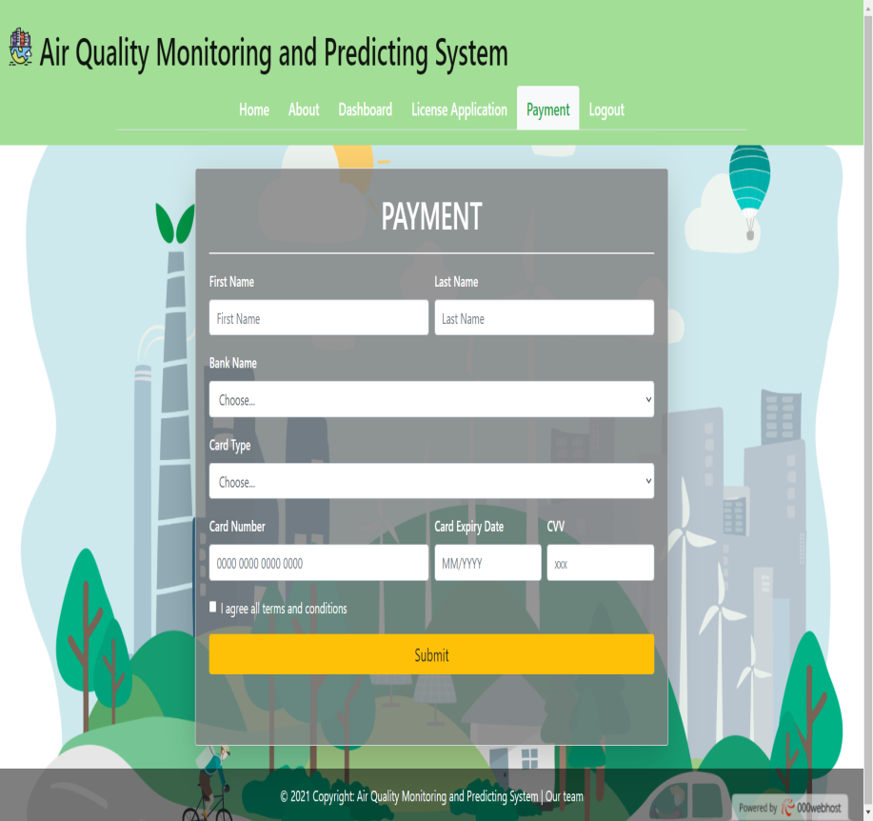
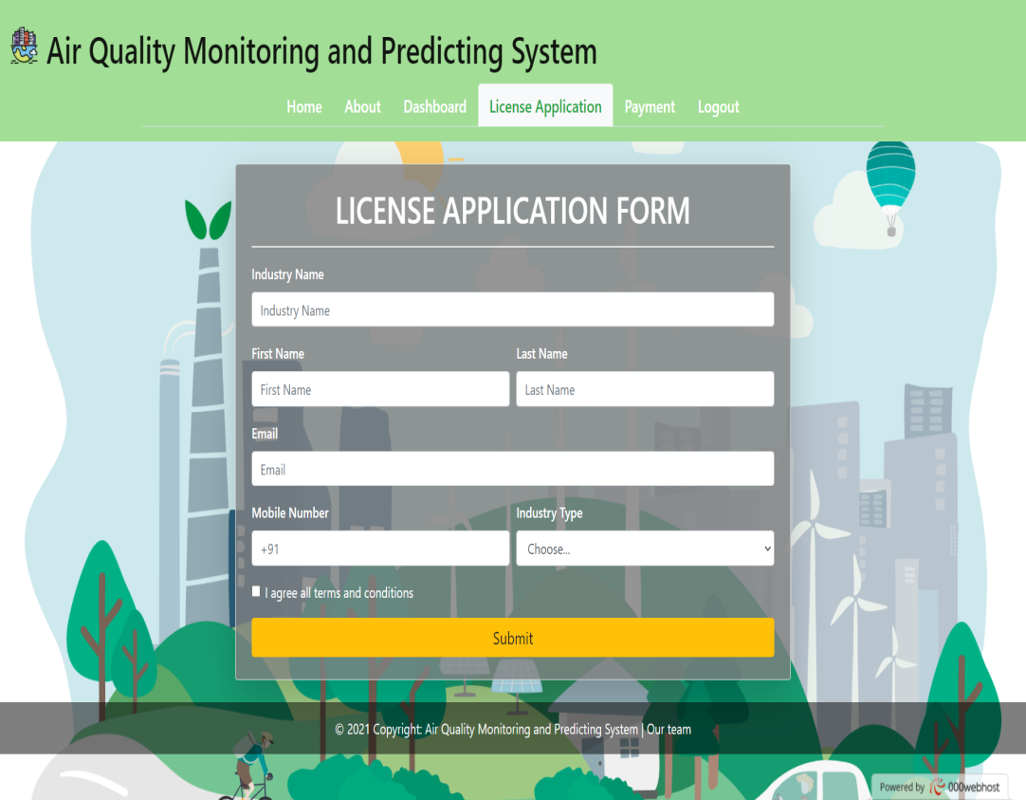
LICENSE APPLICATION FORM
PAYMENT

Slide 26
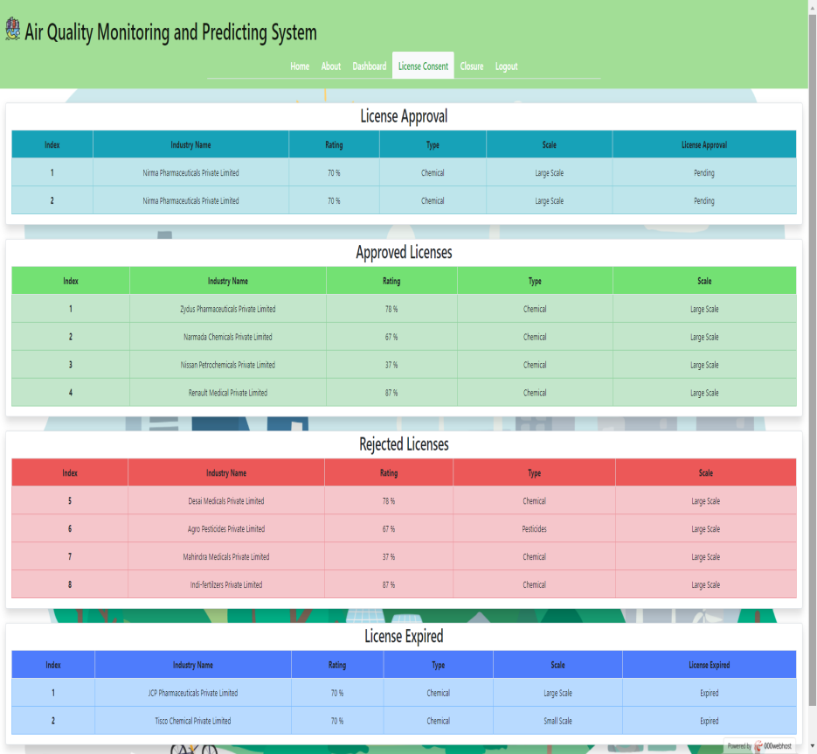
LICENSE APPROVAL PAGE

Slide 27
DATA DICTIONARY

Slide 28
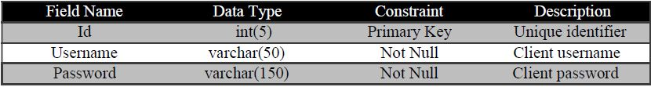
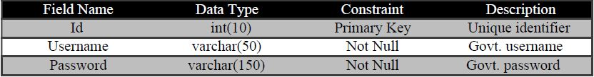
Client Table
Government Table

Slide 29
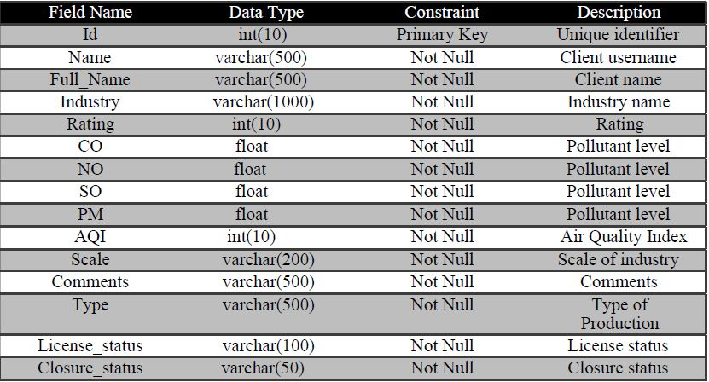
Client Details Table

Slide 30
SYSTEM DESIGN DIAGRAMS

Slide 31
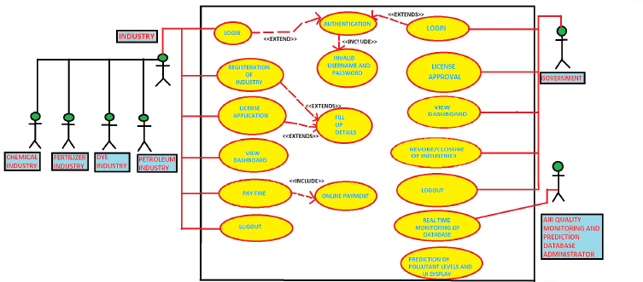
Use Case Diagram

Slide 32
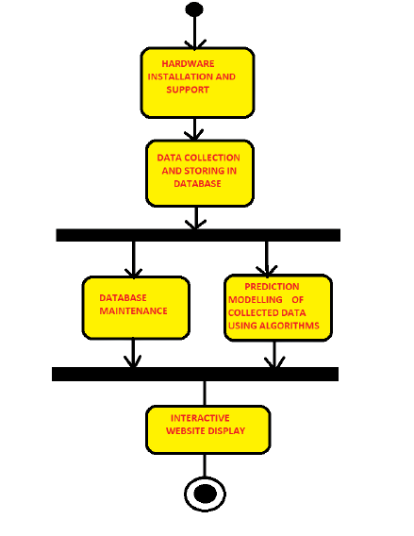
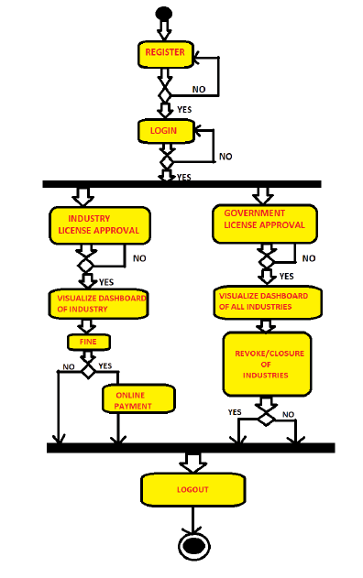
Activity Diagram
User
Admin

Slide 33
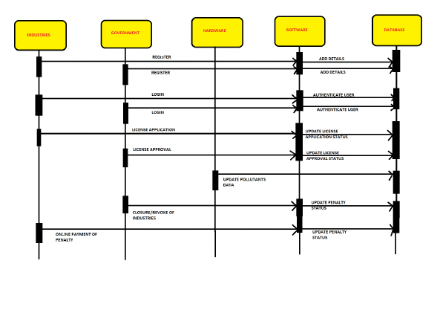
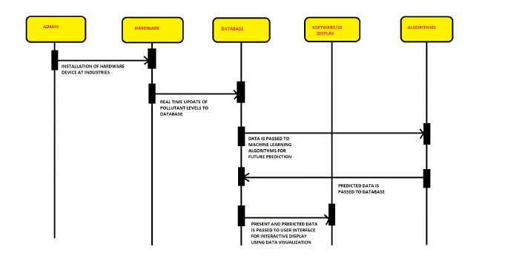
Sequence Diagram:-
User
Admin

Slide 34
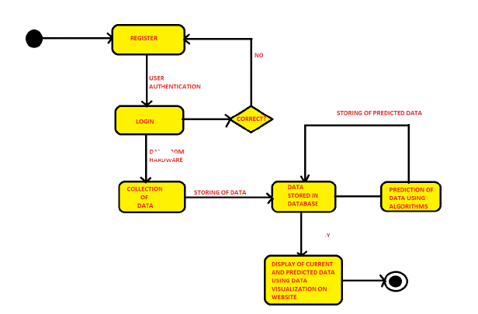
State Diagram

Slide 35
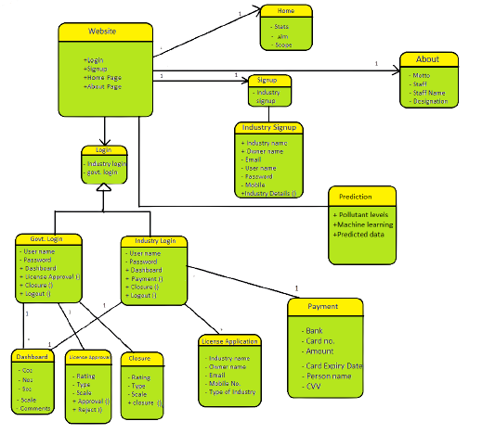
Class Diagram

Slide 36
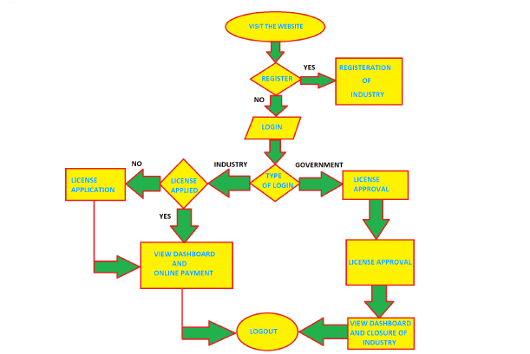
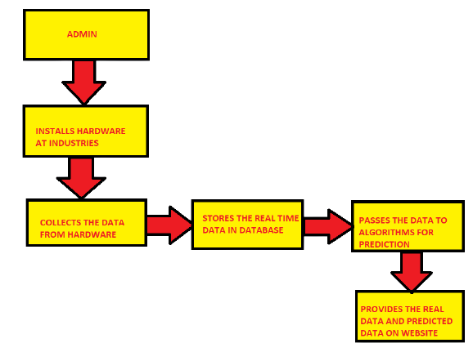
Data Flow Diagram
Admin
User

Slide 37
FUTURE ENHANCEMENTS

Slide 38
Identify bugs and errors in the source code.
Gather data to increase accuracy of the algorithm.
Implement various simplification and website upgrades on the basis of feedback.
Merge the air quality index data gathered from the devices on traffic signals with the vehicular traffic data and suggest drivers different routes that will help them pass through areas with low level of pollution and traffic.

Slide 39
CONCLUSION

Slide 40
Implementation of the project has great significance to the development of social economy.
The project will help in controlling the pollution levels throughout the country
and maintaining a safer environment for everyone.
It will also help the government agencies and industries in maintaining the Air Quality Index under the specified limit.
It will also predict the pollution levels to keep a better check on the environment levels and maintaining the air quality.

Slide 41
THANK YOU

